Slide 1

A.P. Shah Institute of Technology G.B.Road, Kasarvadavli,
Thane(W).Mumbai-400615
UNIVERSITY OF MUMBAI
Academic Year 2023-2024

Slide 2
VOICE BASED EMAIL FOR
VISUALLY CHALLENGED
BY
Aafreen Khan(22106048)
Prachiti Parab(22106030)
Sneha Gupta(22106046)
Sidra Khan(22106028)
UNDER THE GUIDANCE OF
Prof. Shraddha Dalvi

Slide 3
INDEX
INTRODUCTION
PROBLEM STATEMENT
OBJECTIVES
SCOPE
BLOCK DIAGRAM
TOOLS AND LANGUAGE USED
IMPLEMENTATION
CONCLUSION

Slide 4
INTRODUCTION
The project is a python-based application for visually impaired persons using speech to text voice response, thus enabling everyone to read , send, and perform all the other useful tasks.
The system will prompt the user with voice commands to perform certain action and the user will respond to the same.

Slide 5
PROBLEM STATEMENT
The visually challenged community faces significant barriers when it comes to accessing and managing email communication. Traditional email interfaces heavily rely on visual elements, making it challenging for visually impaired individuals to independently read, compose, and manage emails.

Slide 6
OBJECTIVES
To implement Speech Recognition and Interpretation
To perform text-to-Speech Conversion
To Access Email Interface
To implement a user-friendly and intuitive voice interface
To implement secure authentication methods

Slide 7
SCOPE
Accessibility and Inclusivity
Voice Commands and Control
Speech Recognition and Dictation
Screen Reader Integration
Internationalization and Multilingual Support
Integration with Other Technologies

Slide 8
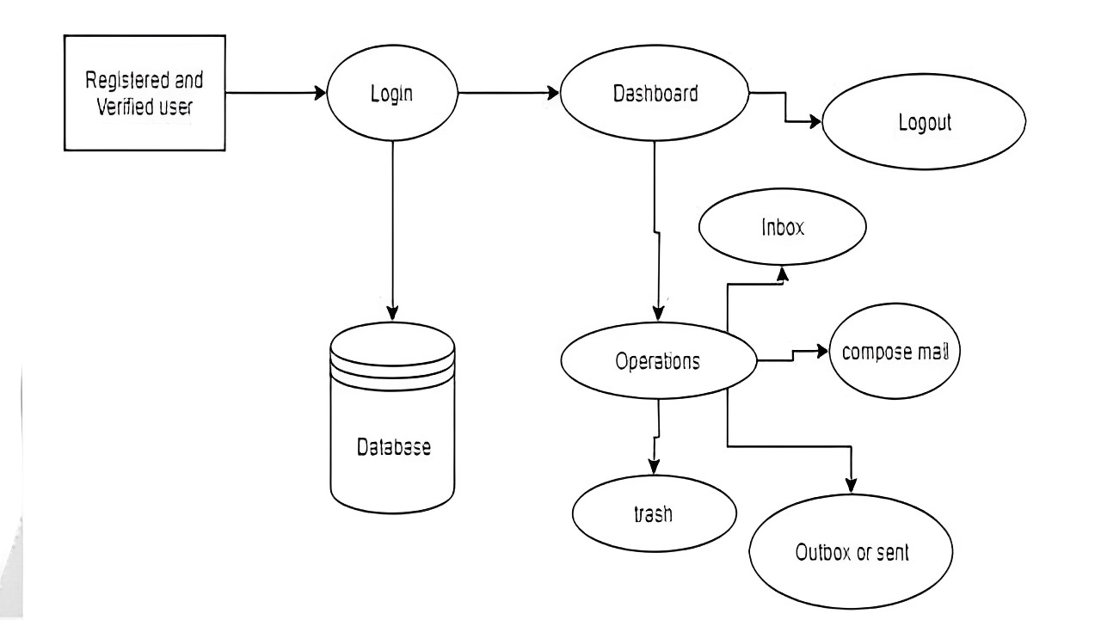
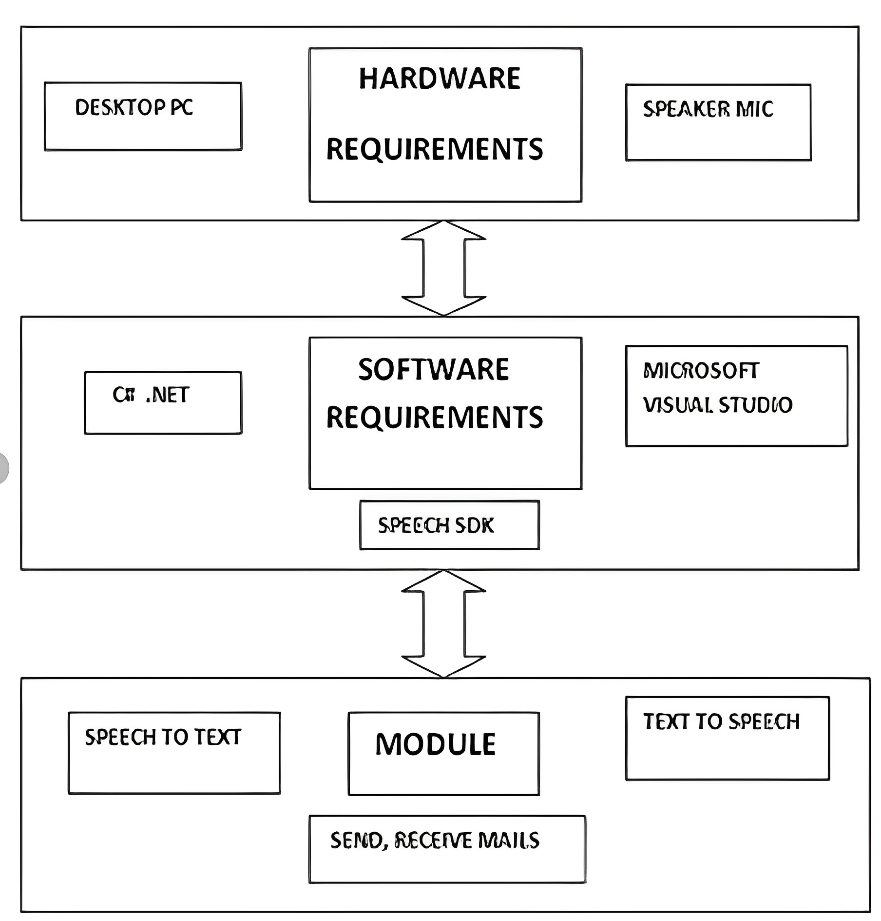
BLOCK DIAGRAM

Slide 9



TOOLS AND LANGUAGE USED
LANGUAGE
IDE
TOOLS
PYCHARM
GITHUB
PYTHON 3.11.4
TKINTER

Slide 10
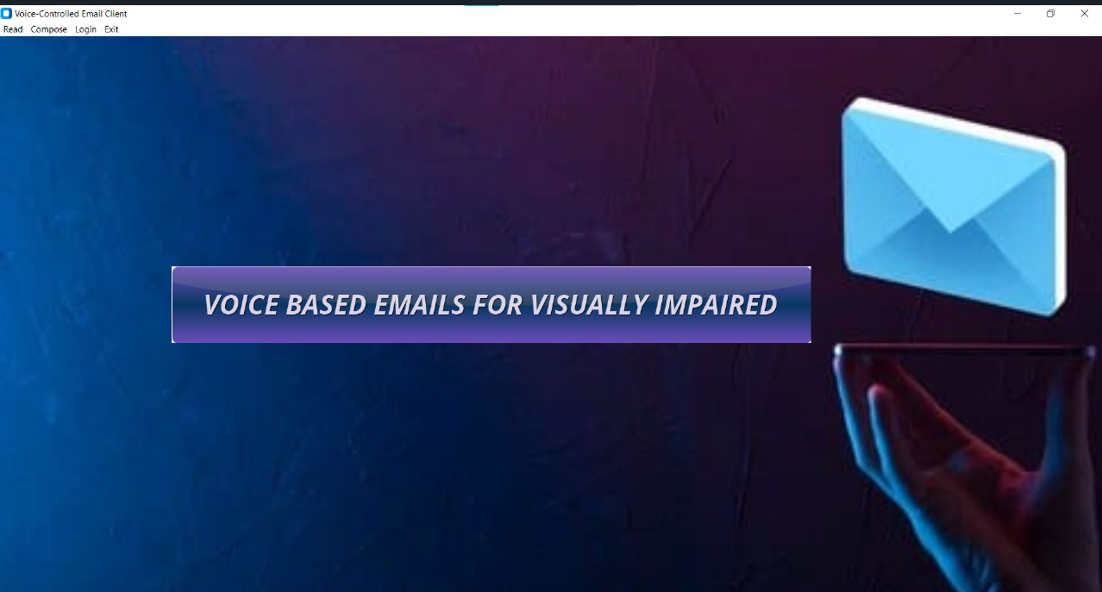
FRONTEND IMPLEMENTATION

Slide 11
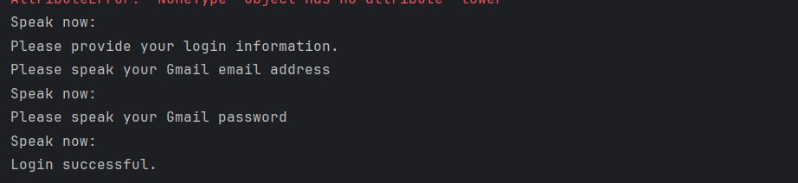
BACKEND-LOGIC IMPLEMENTATION

Slide 12
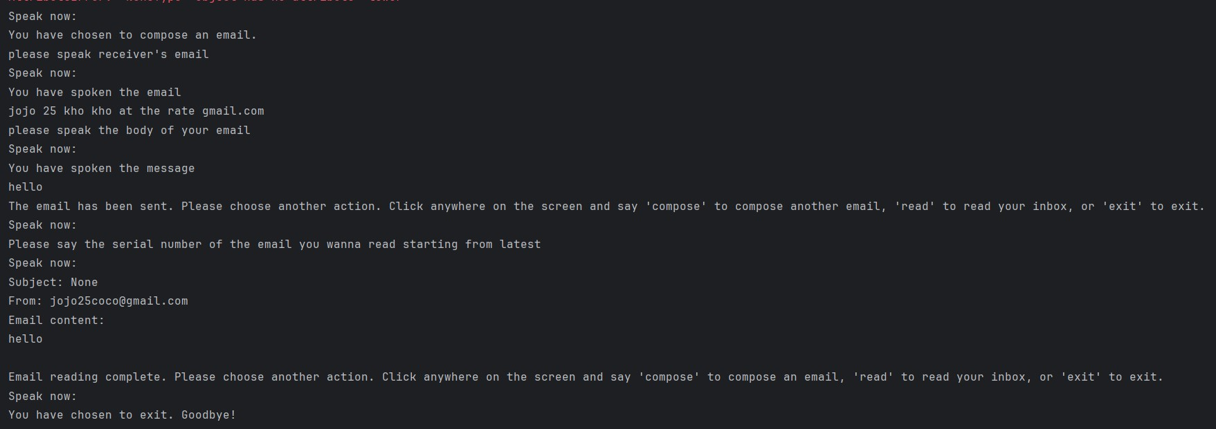

Slide 13
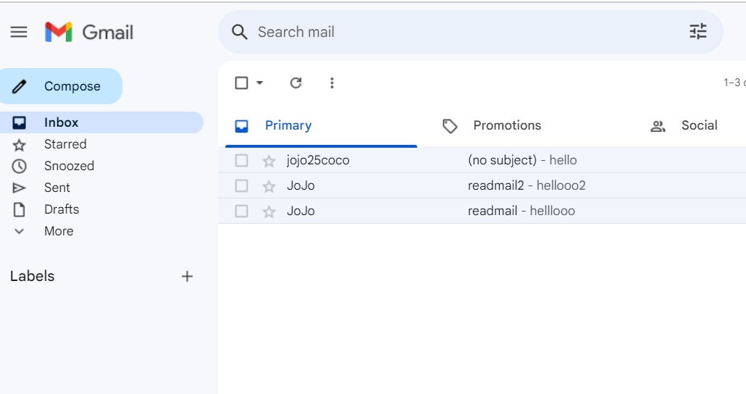
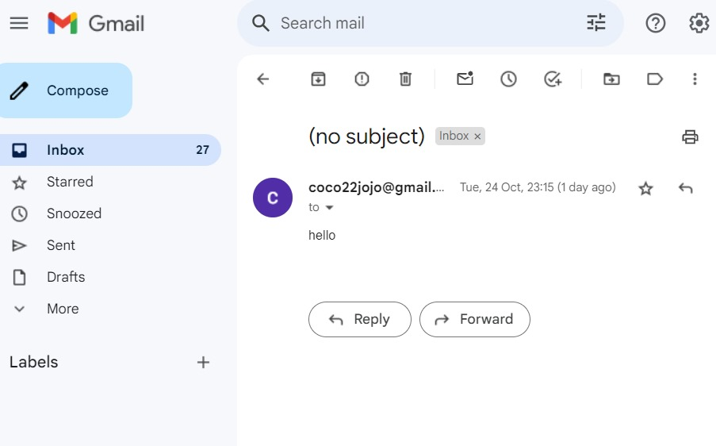
EMAIL SENT
READ EMAIL

Slide 14
CONCLUSION
This email is used by any user of any age group.
It empowers visually challenged.
Key features include speech recognition, text-to-speech capabilities, and customizable commands.
This innovation promotes independence and productivity in email management.
It opens doors to education, employment, and social interaction for visually challenged individuals.

Slide 15
REFERENCE
https://realpython.com/python-speech-recognition/
https://pypi.org/project/gTTS/
https://realpython.com/python-send-email/
Python Crash Course by Eric Matthes
https://www.sarkarirush.com/python-crash-course-pdf/
THANK YOU

